Slide 1
Trip Advisor Dashboard
Created by: Akshat Sharma
Reg no: 12218629
Roll No: 22
Section: K22ZM

Slide 2
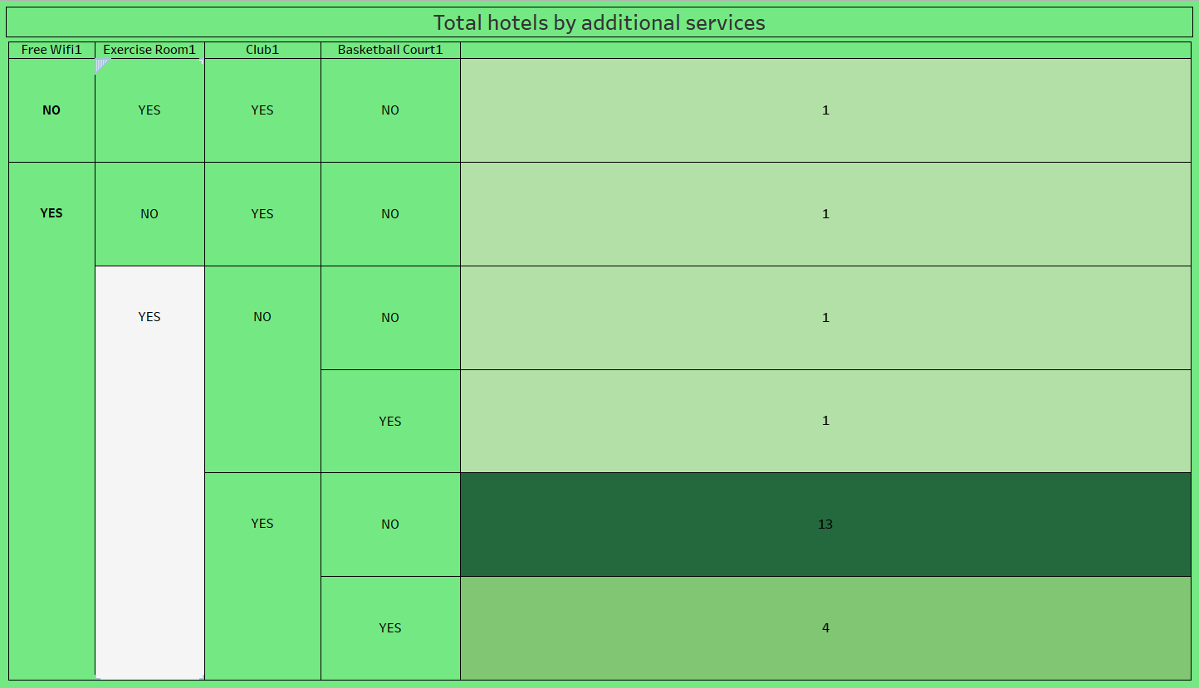

Slide 3
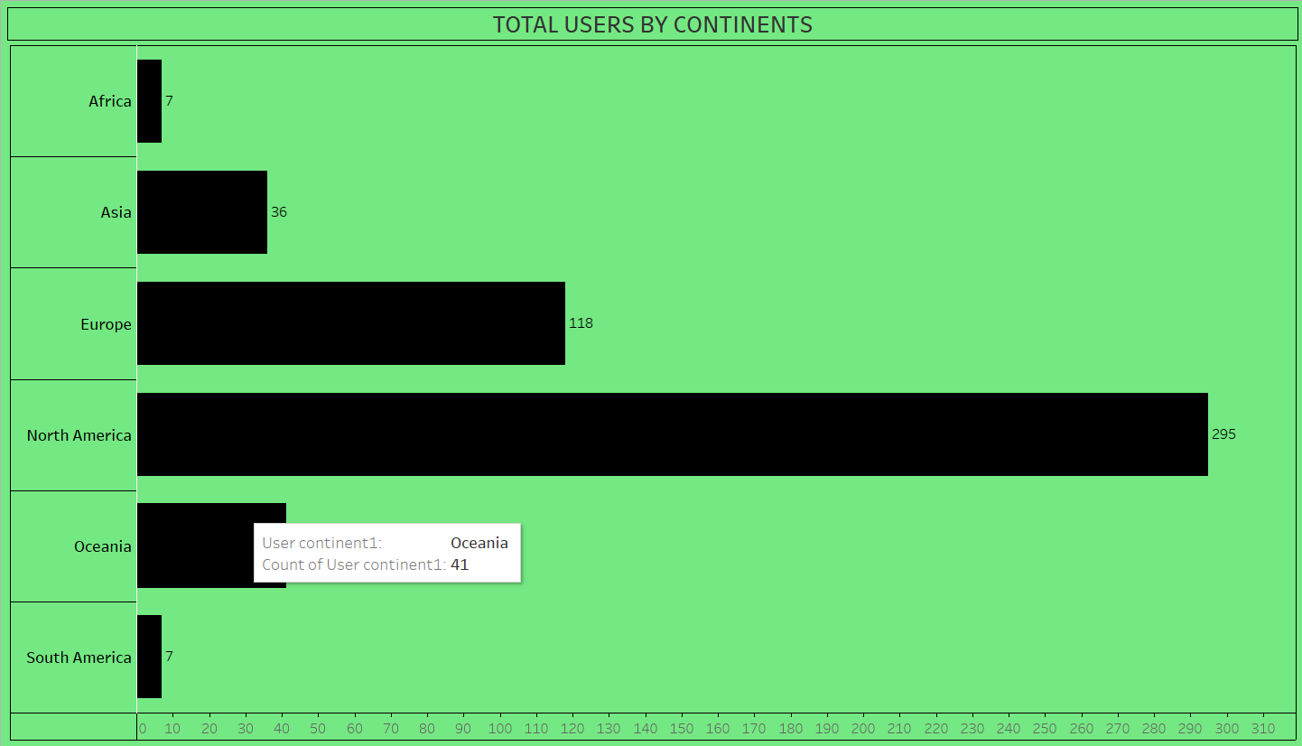

Slide 4
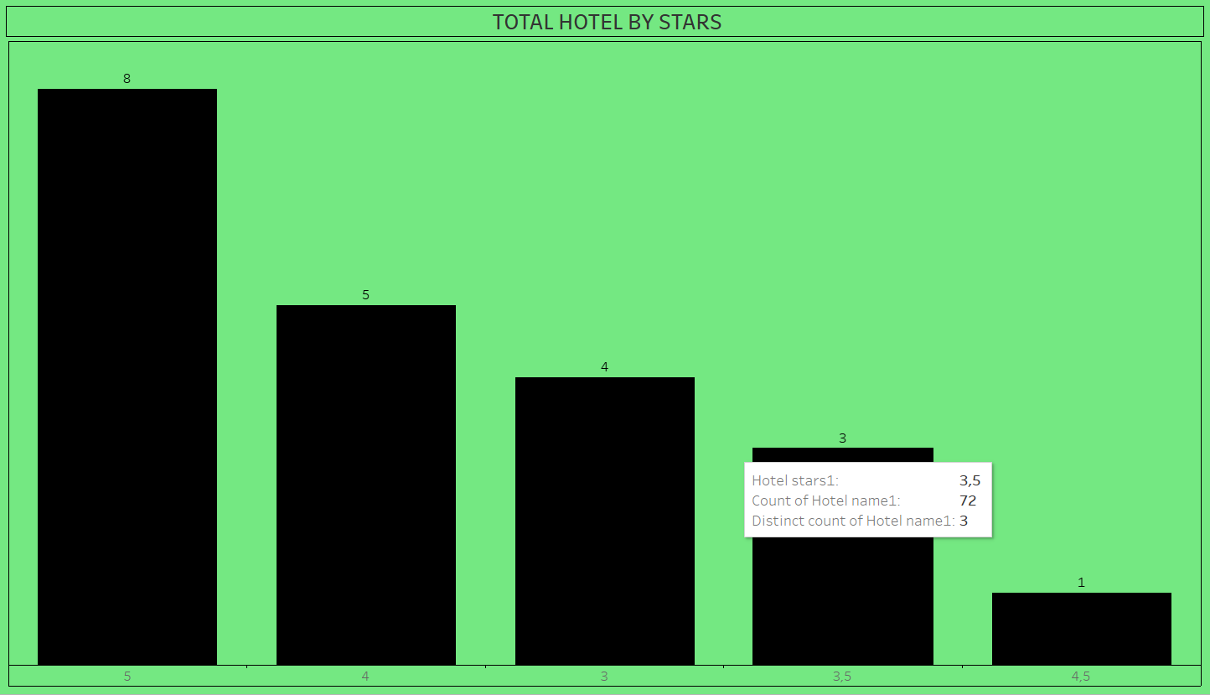

Slide 5
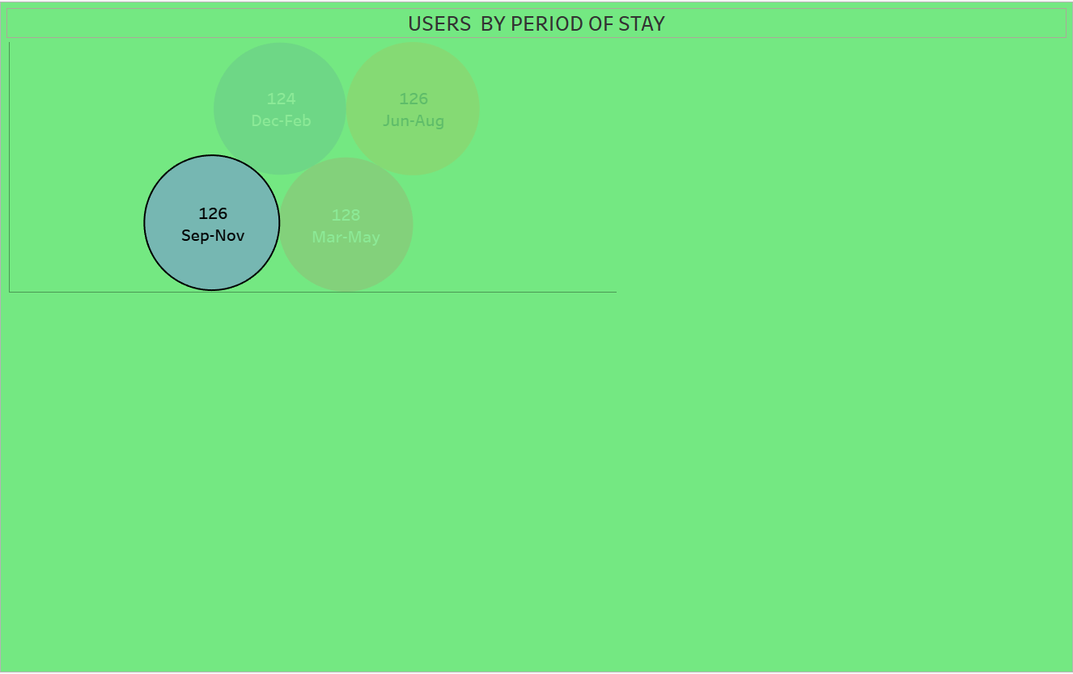

Slide 6
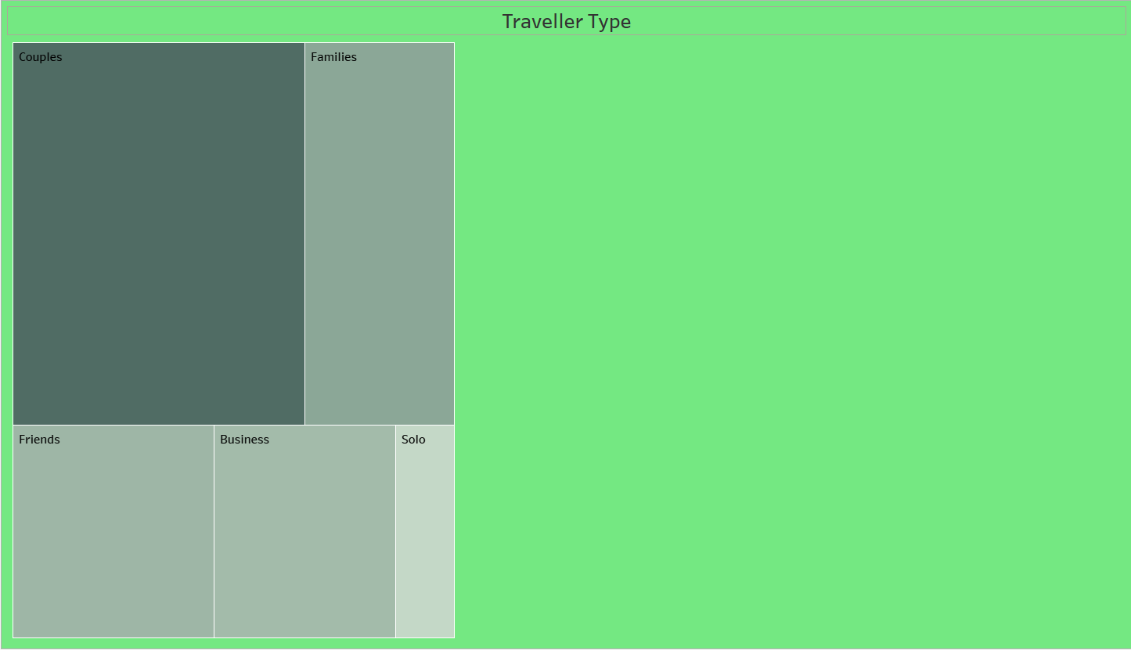

Slide 7
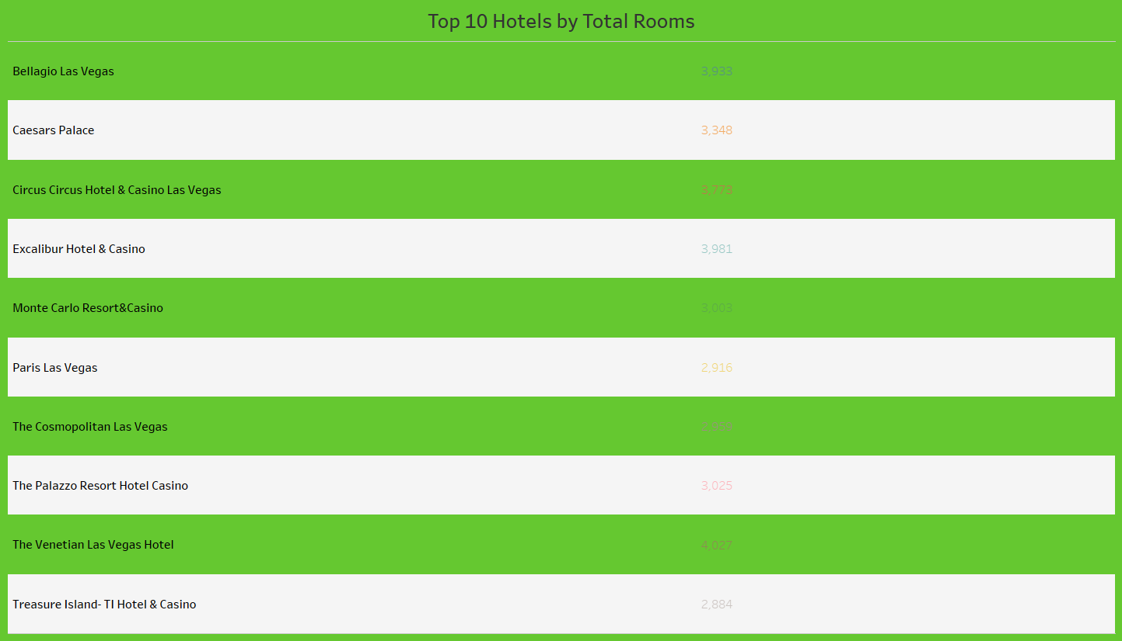

Slide 8
